Slide 1
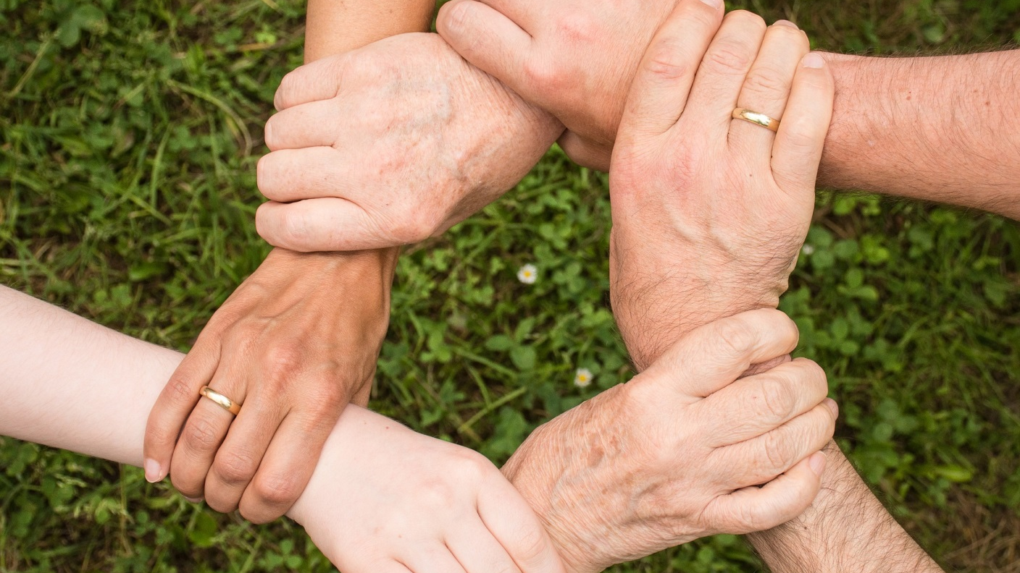

Crowd Aid
We will help you answer health or medical needs through crowdsourcing

Slide 2

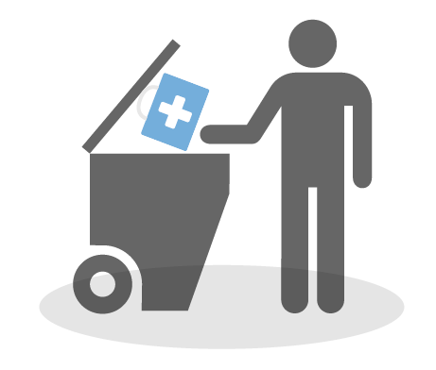

What is the problem?
$765 Billion
Are wasted by U.S. health care system a year and a portion of it are from discarded medical items that are still usable.
400 Million
People do not have access to essential health services and 6% of people are pushed further into extreme poverty because of health spending.
Notes:
In 2012 the National Academy of Medicine estimated that the *Read the slide*. - https://www.propublica.org/article/what-hospitals-waste
Patients are often willing to donate medical products after completing their treatment, but can struggle to find places to take them.
*2nd read* - http://www.bendbulletin.com/news/1361433-153/medical-items-often-wasted
http://www.who.int/mediacentre/news/releases/2015/uhc-report/en/

Slide 3





Solution
Health Institutions
HELP!
Charitable Organizations
Individuals
Government
Notes:
Crowd Aid can help make the discarded but still usable medical items not go to waste by making it available to people who needs it.
The connected health institutions can advertise the medical items or equipment that they do not need.
Charitable organizations, through Crowd Aid, can pick up these discarded items and at the same time they can also advertise what kind of help they can provide to those in needs. These organizations can also analyze the generated report by Crowd Aid to determine what is the part in the community to focus their efforts.
Individuals in the crowd, can use Crowd Aid to check whether they need or know someone who needs the items advertised by the Charitable Orgs and the health institutions. At they same time, they can also advertise the unused medical items they do not need, like wheelchair, oxygen tank and oxygen concentrator and others.
The government can regulate Crowd Aid. And also, the reports generated by Crowd Aid can be analyze to gain better understanding about the health situation of their citizens.
At the same time it can also help the people in needs.

Slide 4
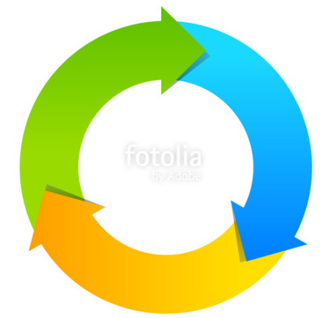

Solution - Benefits
Billions of dollars could be saved each year by salvaging still useful medical products.
Notes:
With the rising cost of medical products it is estimated that billions of dollars could be saved each year by salvaging or reusing still useful products and making it available to the people who needs it.
http://www.bendbulletin.com/news/1361433-153/medical-items-often-wasted

Slide 5


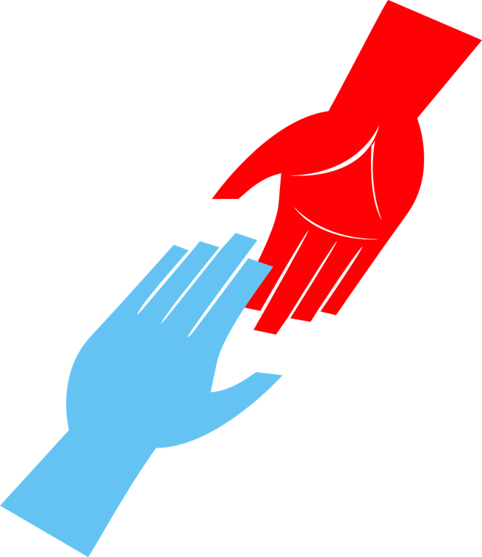
Solution - Benefits
AI and crowdsourcing can provide efficient and quick response to the people using Crowd Aid.
Notes:
By utilizing AI and crowdsourcing, Crowd Aid can provide efficient and quick response to the people requesting for help.

Slide 6





Solution - Benefits
There is more...
Data
Patterns
Trends
Demographics
Other statistics
Notes:
Crowd Aid will be capable of producing big data reports to show patterns, trends, demographics and others relating to health situation in the community.

Slide 7


Architecture – Crowd Aid
Text Analytics
API
Medical items
Monetary
Information
API Processor
View
Controller
Reporting
User
Data Matching
Interaction once agreement has been reached
Database
Database Models
Crowd
Notes:
The data inputted by the user could be medical items, monetary or information.

Slide 8
Future Enhancement
Multiple language support
Online financial transaction and escrow feature

